Slide 1
Physical & Chemical Properties
What ‘s the matter with you

Slide 2
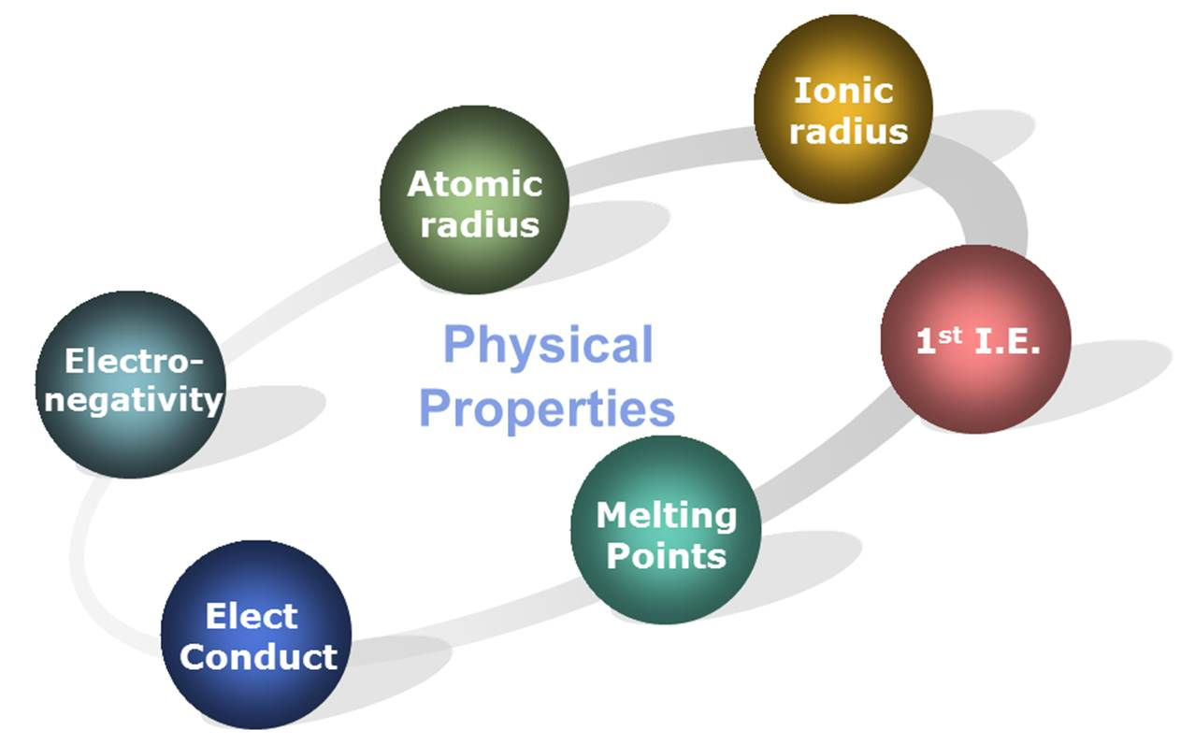
Properties of matter
Property: is a feature of a substance such as it’s ___________, _________ or _________
Grouped into 2 categories: chemical and physical

Slide 3
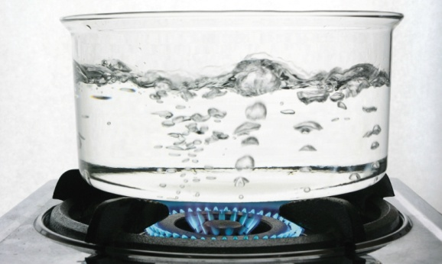
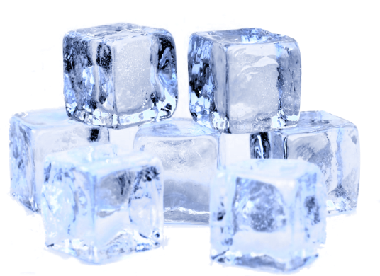
Physical property
Use your senses to describe it
Colour | Red, blue, green
State
Ductility
Malleability
Boiling point
Melting point
Freezing point
conductivity
Solubility
Crystal form
Density
Viscosity

Slide 4

Describe water
Uses your senses to describe it
Colour
____________
State (solid, liquid gas)
____________
Ductility (made into wire)
____________
Malleability (bendable)
____________
Boiling point
____________
Melting point
____________
Freezing point
____________

Slide 5

Chemical property
When it changes into something new
_________________________
_________________________
_________________________
_________________________
_________________________
_________________________

Slide 6
Properties of matter summary
Physical | Chemical
Colour State (solid liquid or gas) Ductility (made into wire) Malleability (bendable) Boiling point Melting point Freezing point Conductivity Solubility Crystal form | Flash point Reaction to water Reaction to heating Combustibility Flammability Toxicity * is a characteristic when one substance undergoes a chemical reaction

Slide 7
Practice
Classify the following is a physical or chemical property
Water boiling at 100 degrees C
Gasoline burning when exposed to flame
Sugar dissolving in water
Diamonds cutting glass
Dying your hair green
C or P
C or P
C or P
C or P
C or P

